Slide 1

Proposal for a Common
Field Calibrator Software Interface

Slide 2
The Problem
No Calibrator Hardware Interface Standard
  Different physical connections
  Different protocols and data formats
  Different data
No Software Interface Standard
  Proprietary drivers for each software package
  Multiple drivers for each calibrator

Slide 3
Solution Goals
Application Independent Driver Interface
Use Existing, Accepted Technology
Isolate Functionality
  Data collection
  Data analysis and presentation
Support Common and Specific Features
Open Standard

Slide 4
Field Calibrator Interface
Based on MS Component Object Model
Specification Defined by FCTC
Defines Common Data and Exchange
Single Driver (Server) per Calibrator
Interface to Any Application (Client)

Slide 5
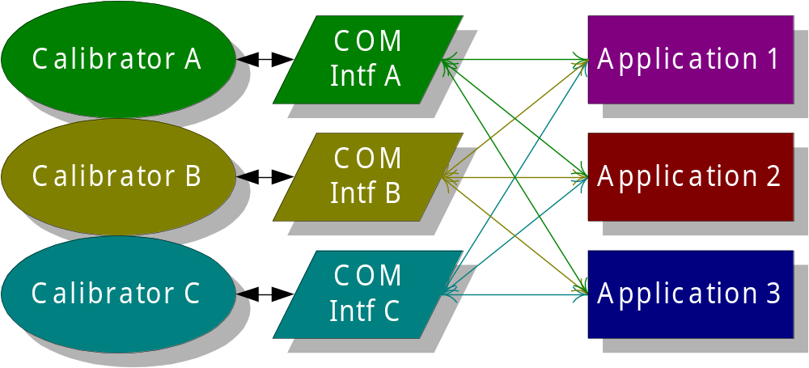
FCINTF COM Solution

Slide 6
Component Object Model
Binary Standard (multiple platform)
Readily Available Development Tools
Accepted by Industry
  OPC
  Object Automation

Slide 7
What Is FCINTF
It is a specification (a piece of paper).
It defines a set of Interfaces...
And describes their behavior...
So that applications and calibrators can exchange data.

Slide 8
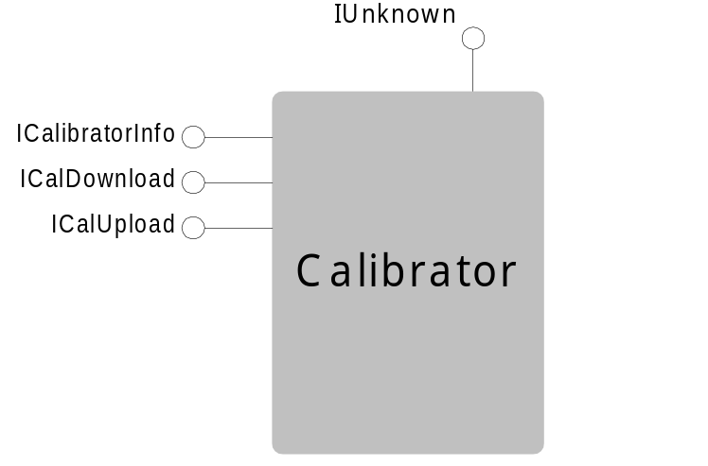
Logical Model
IUnknown
ICalibratorInfo
ICalibratorDownload
ICalibratorUpload
IDispatch

Slide 9
Interfaces
Two sets of interfaces on the same object
  Custom (ICalibratorInfo, etc.)
  Automation (IDispatch)
They provide similar functionality
  Custom works best with C, C++
  Automation works best with VB

Slide 10
ICalibratorInfo
DriverProperties
Open
Close
Properties
GetId
GetCalDates
SetDateAndTime
SetTempStandard
GetTestResultsCount
ClearMemory
ValidateTag

Slide 11
ICalibratorDownload
StartDownloading
DownloadTag
FinishDownloading
AbortDownload

Slide 12
ICalibratorUpload
StartUploading
UploadNextTag

Slide 13
Current Status
Custom Interface Ready for Review
  ftp://ftp.swri.edu/fctc/fcintf.zip
Automation Interface Needs Work
Needs Careful Consideration by both Application Software and Calibrator Vendors

